Slide 1


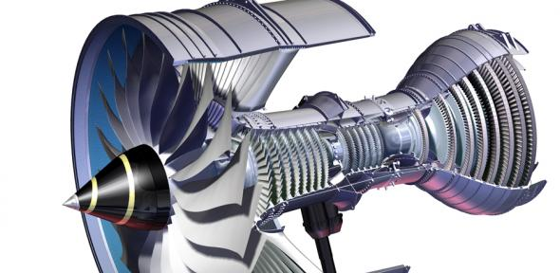
Super Alloys
Ciencia de los materiales
Manolo Zerrweck Vazquez 1889146
07/05/2018

Slide 2
Super alloys definition:
Superalloys, or high performance alloys, are alloys that have excellent mechanical strength, resistance at high temperatures and oxidation resistance.
They typically have a face-centered cubic crystal structure with a base alloying element of nickel, cobalt, or nickel-iron.
The development of superalloys has been driven by the aerospace and power industries.
Alloying increases the strength and temperature capability but reduces the processability.

Slide 3
Origins:
The term "superalloy" was first used after World War II to describe a group of alloys developed for use in aircraft turbine engines that required high performance at elevated temperatures.

Slide 4
Difference between alloys and superalloys:
An alloy is a metal that is a combination of two or more elements, at least one of which is a metal. A super alloy is basically a high performance alloy with much better properties like resistance to high temperatures.

Slide 5
Properties:
Heat resistant and high strength at high temperatures (760-980°C)
Good corrosion resistance
Good oxidation resistance
High ductility

Slide 6
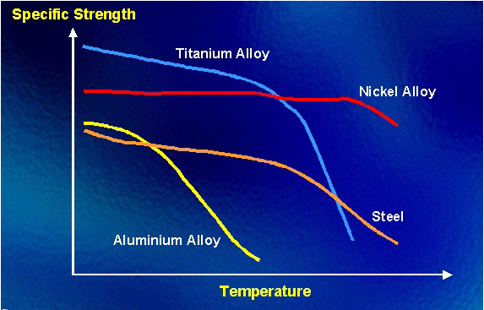
What makes superalloys special?
Generates 2-phase equilibrium microstructure, (y) and (y’)
(y’) Contributes to:
Elevated temperature strength of alloy.
Resistance to creep deformation.

Slide 7
Classification:
There are three types of nickel-base superalloys:
Nickel base
Nickel-iron base
Cobalt base

Slide 8
Chemical composition
Most nickel-based super alloys contain 10-20% Chromium, up to 8% Aluminium and Titanium and 5-10% cobalt.
Chromium and aluminium are necessary for oxidation resistance.

Slide 9
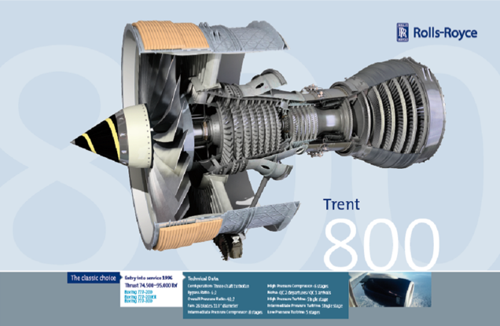
Applications:
Aerospace gas turbine engines.
Space vehicles - Rocket engines.
Nuclear reactors.
Power generation turbines.
Submarines.
Petrochemical equipment.

Slide 10
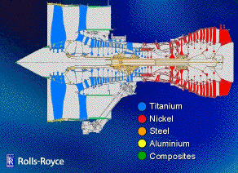
Engine materials:

Slide 11
Conclusion:
Super alloys are crucial in engineering applications.
They have excellent mechanical strength, resistance at high temperatures and oxidation resistance.
High temperature resistance up to 980°C.
They are used in aerospace engines, nuclear reactors and petrochemical equipment.

Slide 12
Bibliography:
http://megamex.com/superalloys.htm
https://www.azom.com/article.aspx?ArticleID=1412
https://www.nickelinstitute.org/NickelUseInSociety/MaterialsSelectionAndUse/Ni-ContainingMaterialsProperties/HighNickelAlloysAndSuperalloys.aspx
https://www.phase-trans.msm.cam.ac.uk/2003/Superalloys/coatings/materials.html

Slide 13
THANKS

